Slide 1
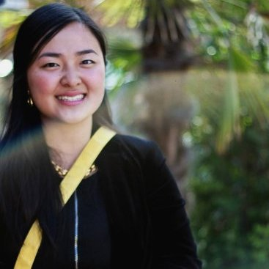
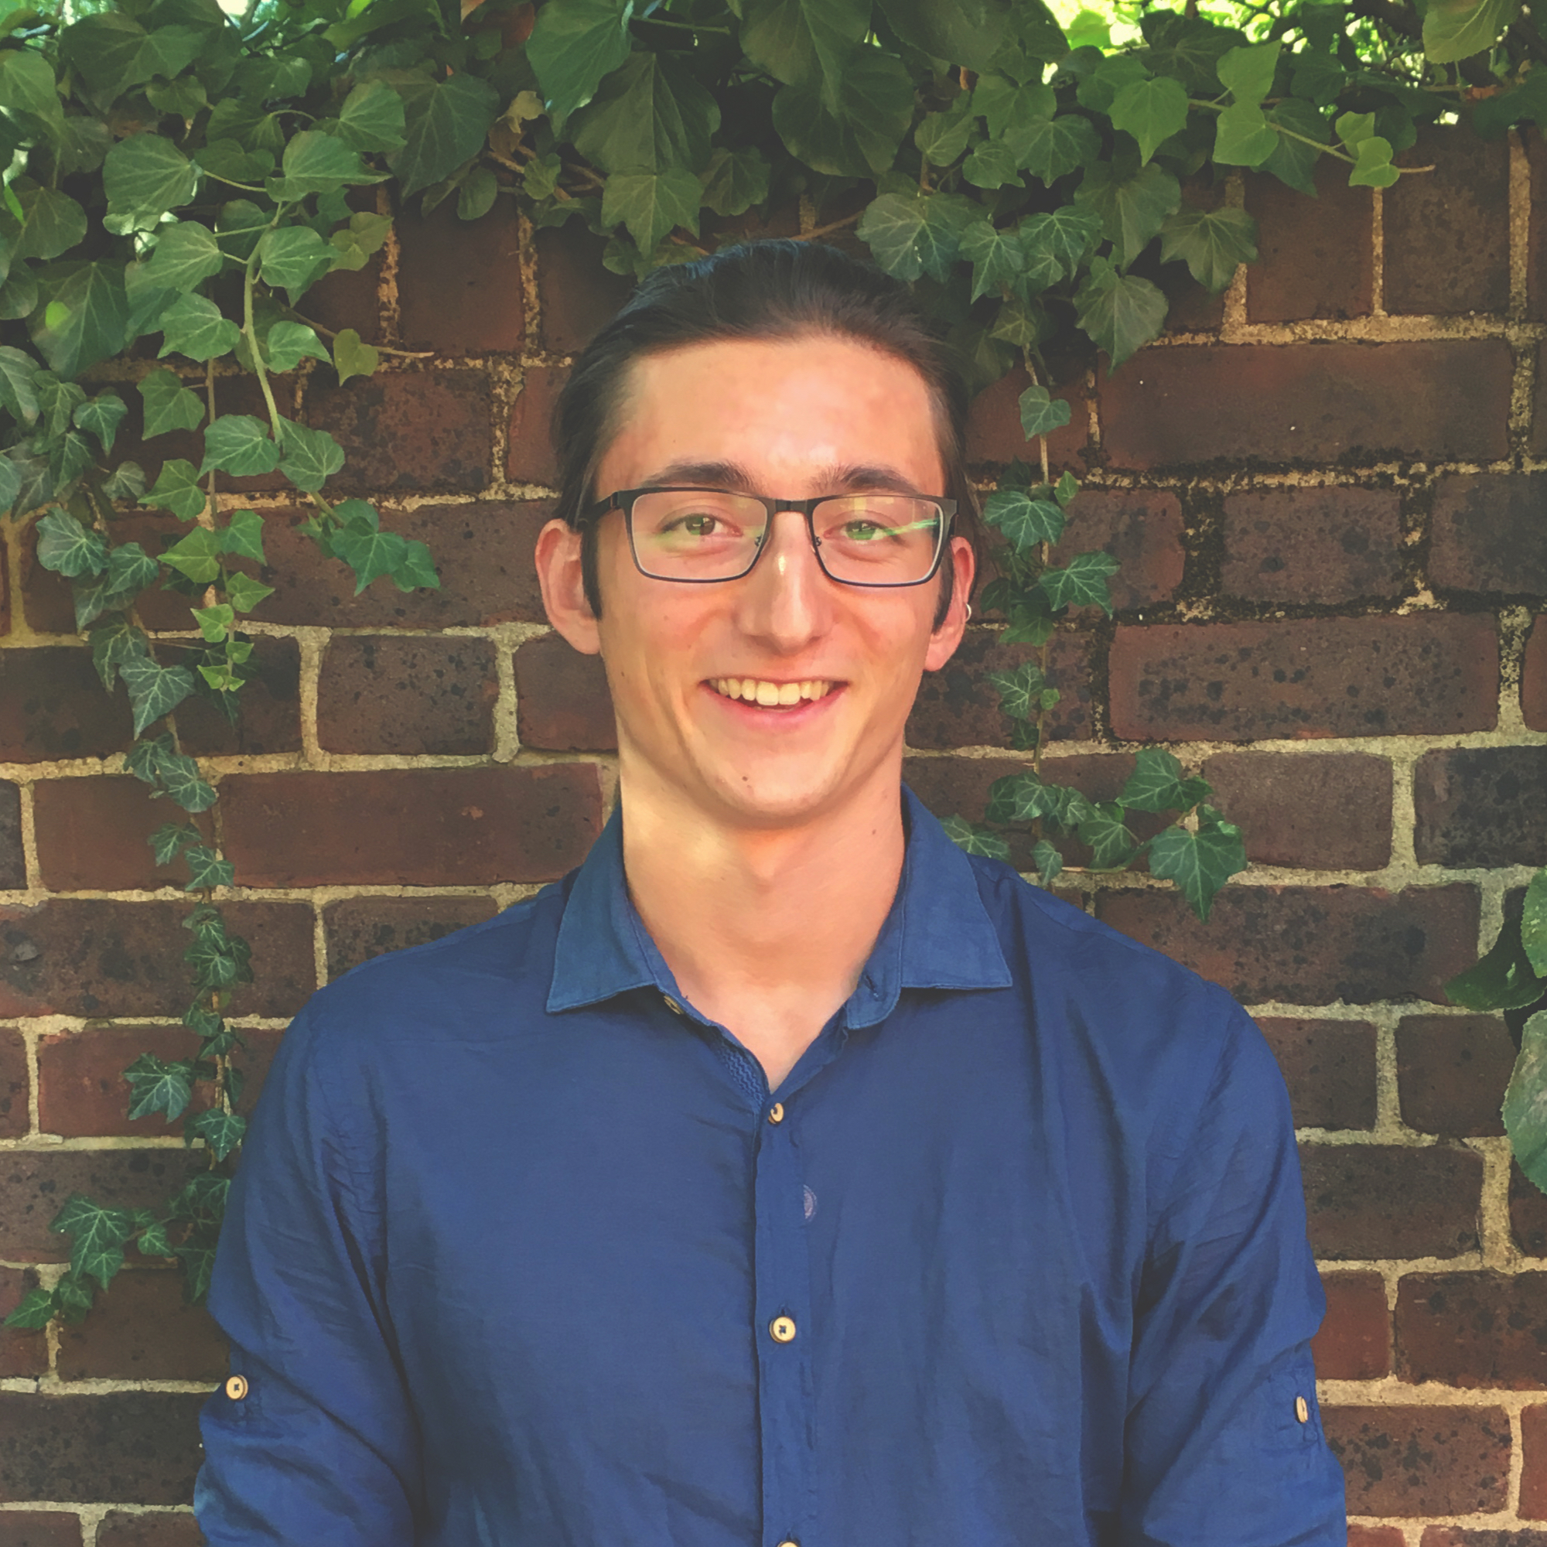
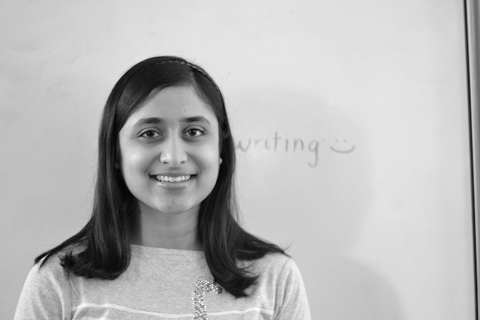
POV and Prototyping

Slide 2
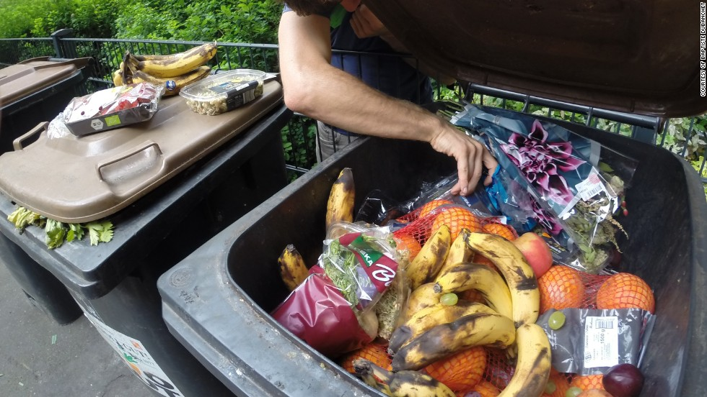
Problem Domain
Food Waste and Food Insecurity
Making food accessible to the food insecure
Producing less waste
Building empathy around food insecurity

Slide 3
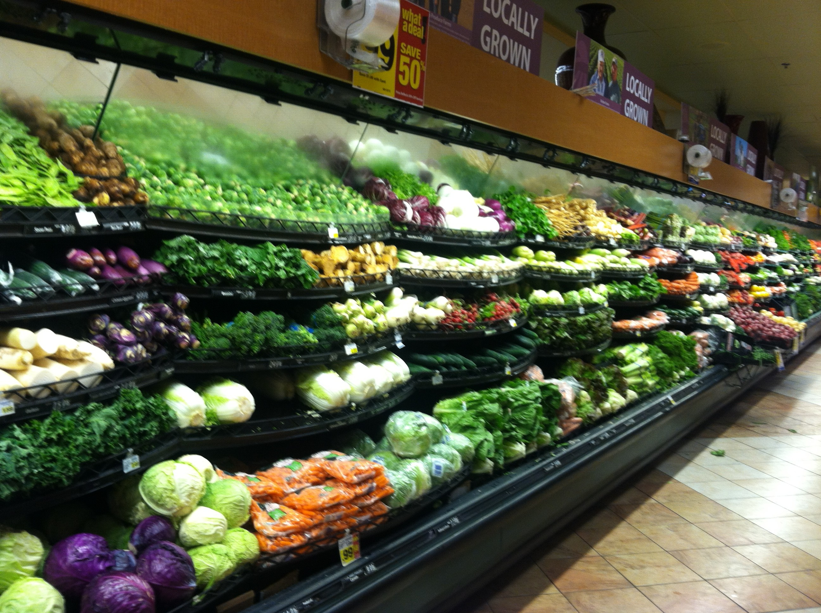
Roadmap
Initial POV
More Needfinding
POVs
Experience Prototypes

Slide 4
Initial POV
We met Nancy from Food Runners. We were amazed to realize that some people do not go to food distributions centers because they feel uncomfortable. It would be game changing to make it less stigmatized to access food.

Slide 5
Roadmap
Initial POV
More Needfinding
POVs
Experience Prototypes

Slide 6
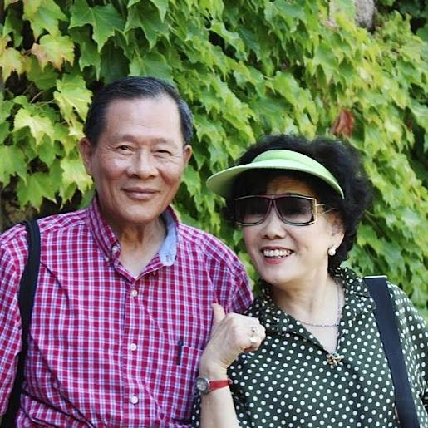
“We found out about Salvation Army from our neighbor in the senior home. She offered to take us one day.”
“It’s very helpful for seniors since we don’t have consistent income. The food can last two weeks and they give us good food like chicken or fish.”

Slide 7
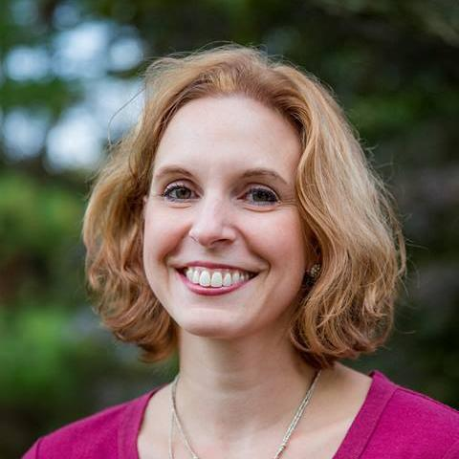
“Lots of wasted food in my household in two types: raw produce and leftovers.”
“Some leftover foods--like soup--can’t be stored for lunch because it’s too messy. ”
Carol Elliot

Slide 8
Roadmap
Initial POV
More Needfinding
POVs
Experience Prototypes

Slide 9
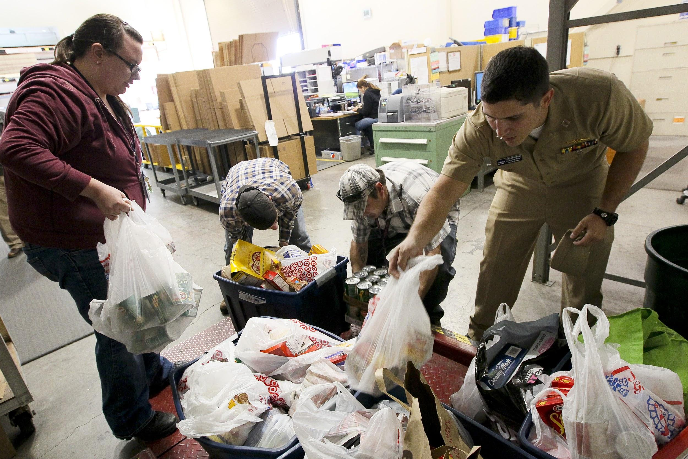
POV #1
We spoke with Nancy, an employee at Food Runners and Nelson, a senior who receives food support.
We were amazed to realize that there are reasons that prevent people from going to food distribution centers, such as lack of knowledge and discomfort.
It would be game-changing to drive more people to food distribution centers.

Slide 10
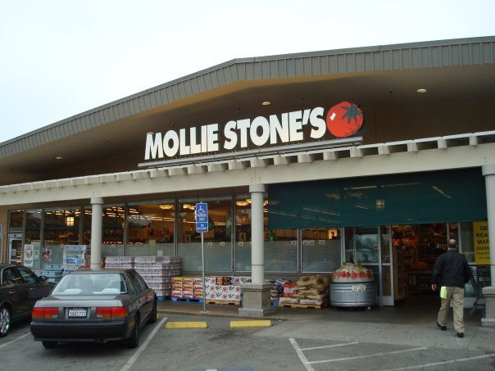
POV #2
We spoke with Andy, a produce manager at the Mollie’s Stones grocery store.
We were amazed to realize that a significant percentage of food waste is derived from poor predictions of the expected consumption and/or purchase of food in the workplace and grocery stores.
It would be game changing to be able end the trend of over-ordering.

Slide 11

POV #3
We spoke with Kate, the Director of Project Management at the Second Harvest Food Bank.
We were amazed to realize that the donations received are often not the type most needed by recipients & monetary contributions are strongly preferred.
It would be game-changing to ensure that the type of donations given actually match the type of donations needed.

Slide 12
Roadmap
Initial POV
More Needfinding
POVs
Experience Prototypes

Slide 13
HMW #1
HMW make food more accessible for the food insecure?

Slide 14
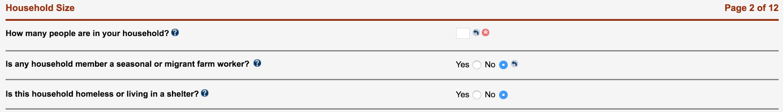
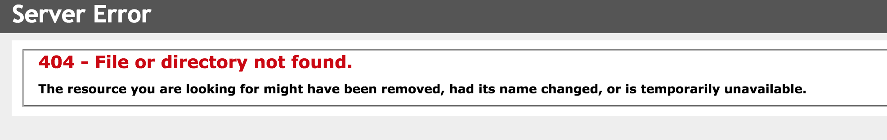

Slide 15
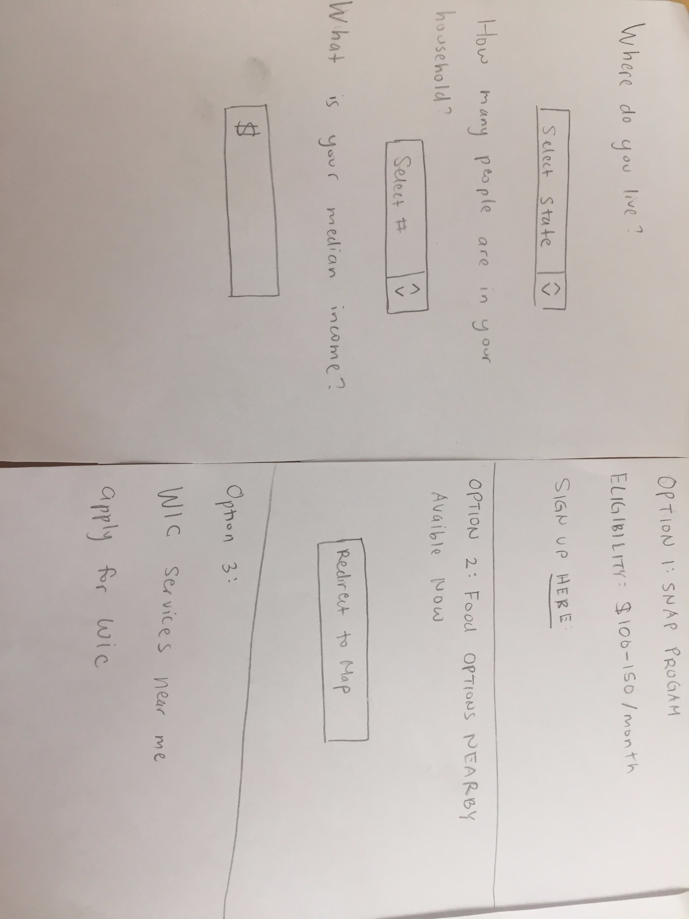
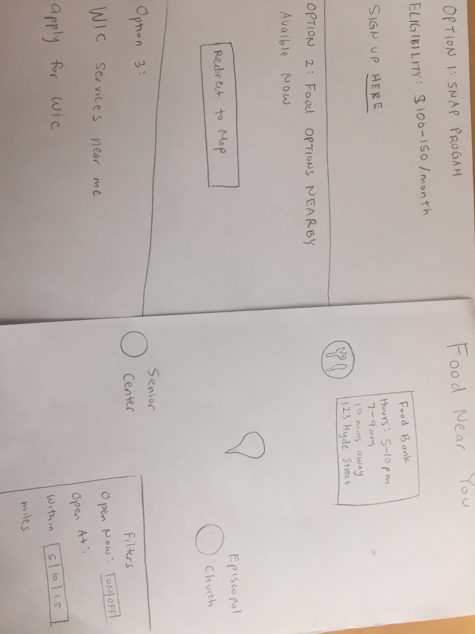

Slide 16
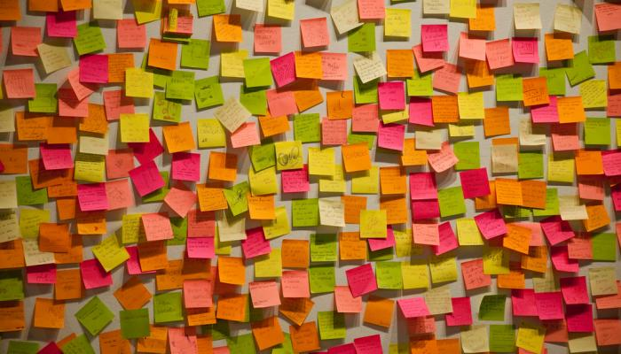
What Worked | Didn’t Work | Surprises and New Learnings
Easy to look at all available options Easy to fill in information | Needed more information on each option Need to ask more questions in the form | Wanted both long term and short term options Need to give a short summary of each option/ how long it would take

Slide 17
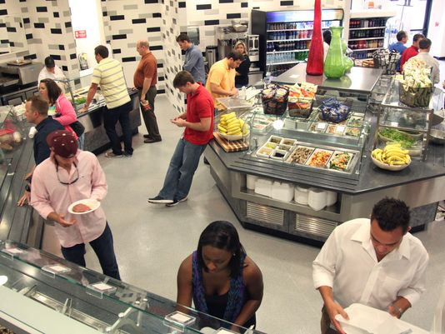
HMW #2
HMW better predict food needs for consumers and producers?

Slide 18
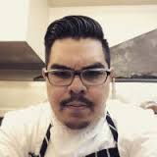
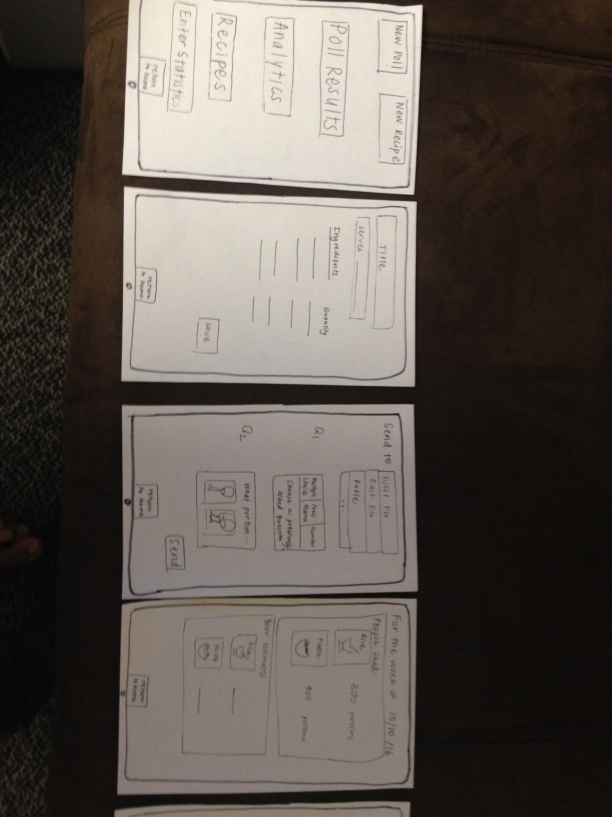
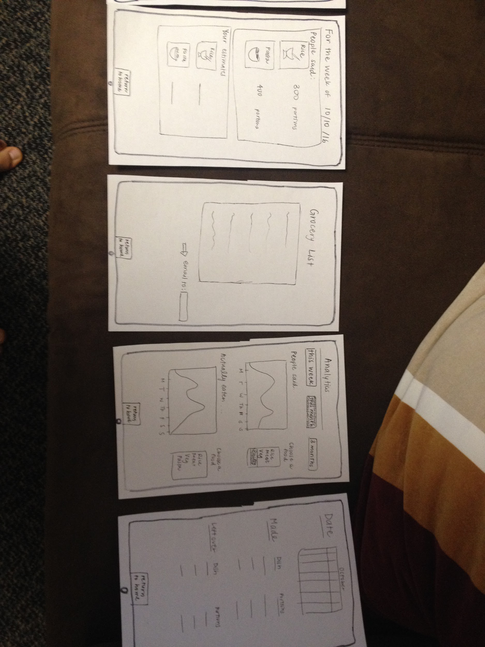
PROTOTYPE: Food Preparation Prediction Tools
Idea: Give chefs tools to predict and track how much food is consumed to reduce excess
Participant: Peter Ochoa, Executive Chef of Florence Moore Dining, Stanford University
Notes:
Paper prototype of the app’s workflow,
“Off the record” discussion of opinions and needs

Slide 19
What Worked | Didn’t Work | Surprises and New Learnings
“Idea is right on!” Liked the feature of sending out polls to figure out how much people think they would eat | Scaling recipes from small portions to ~800 people predictively is not linear mathematically Chefs use units of measure that are hard to standarize: e.g. gram vs. wet gram Hard to calculate the food wasted during process of cooking | “We already have all of this in our system...just not in a mobile app.” Instead of me, the ideal user would be a small business owner who could use it for marketing/menu planning

Slide 20

Assumption | Validity
Head chefs would benefit from a predictive way to gauge how much food to cook. | Valid: “The idea is right on!” The chef seemed happy with what we showed and extremely familiar with the concepts of food analytics.
Chefs do not currently have a means of predicting food volumes based on historical trends. | Invalid: “It’s all there already, just not in mobile app form.”
At large food establishments it’s harder to predict how much food to make. | Invalid: “I have experience working in hotels with ~500 rooms and we always have a head count and guest list.”
Restaurants generally produce food waste due to overprepared food quantities | Invalid: “Chefs in restaurants usually re-cycle food by taking leftovers and repurposing them into another item.”

Slide 21
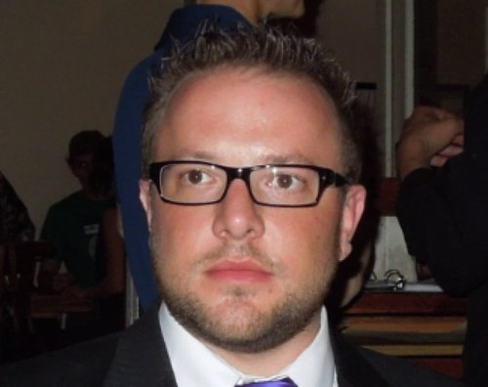
“I can't imagine running this business without the ProductMix software. It’s a very basic spreadsheet with lots of info.”
“Communicating with the chefs is hard sometimes. I remember running around yelling at them about why we’re out of pasta on a Friday night.”
Chris Cuneo
Manager, Mayfield Bakery

Slide 22
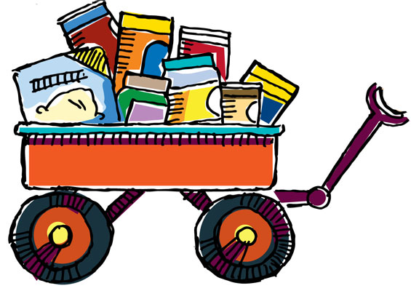
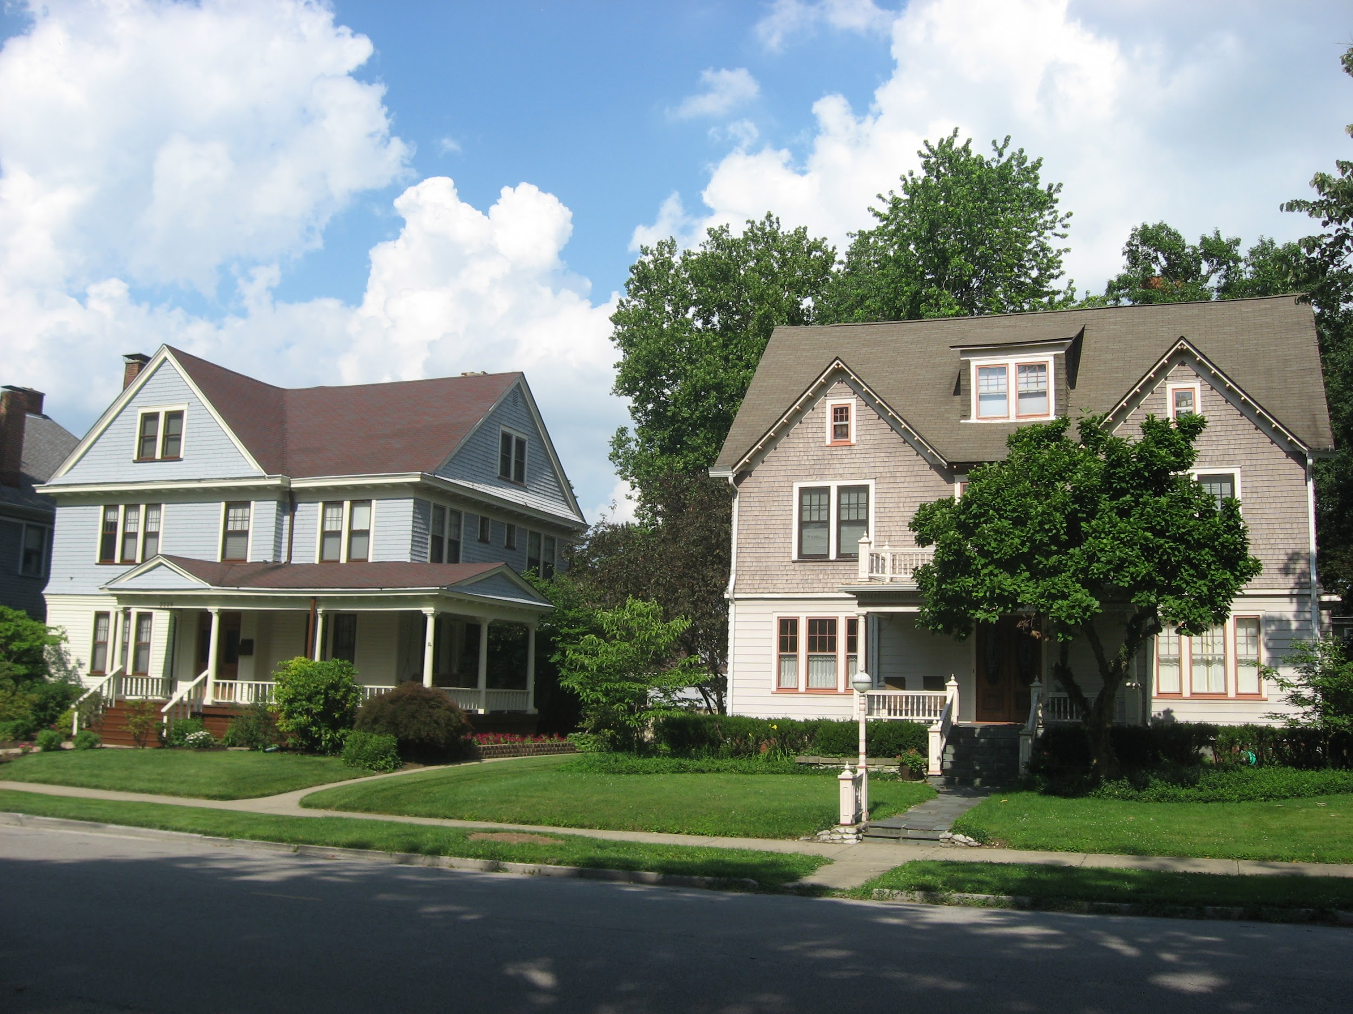
HMW #3
HMW empower and encourage local communities to act upon the issue of food insecurity?

Slide 23
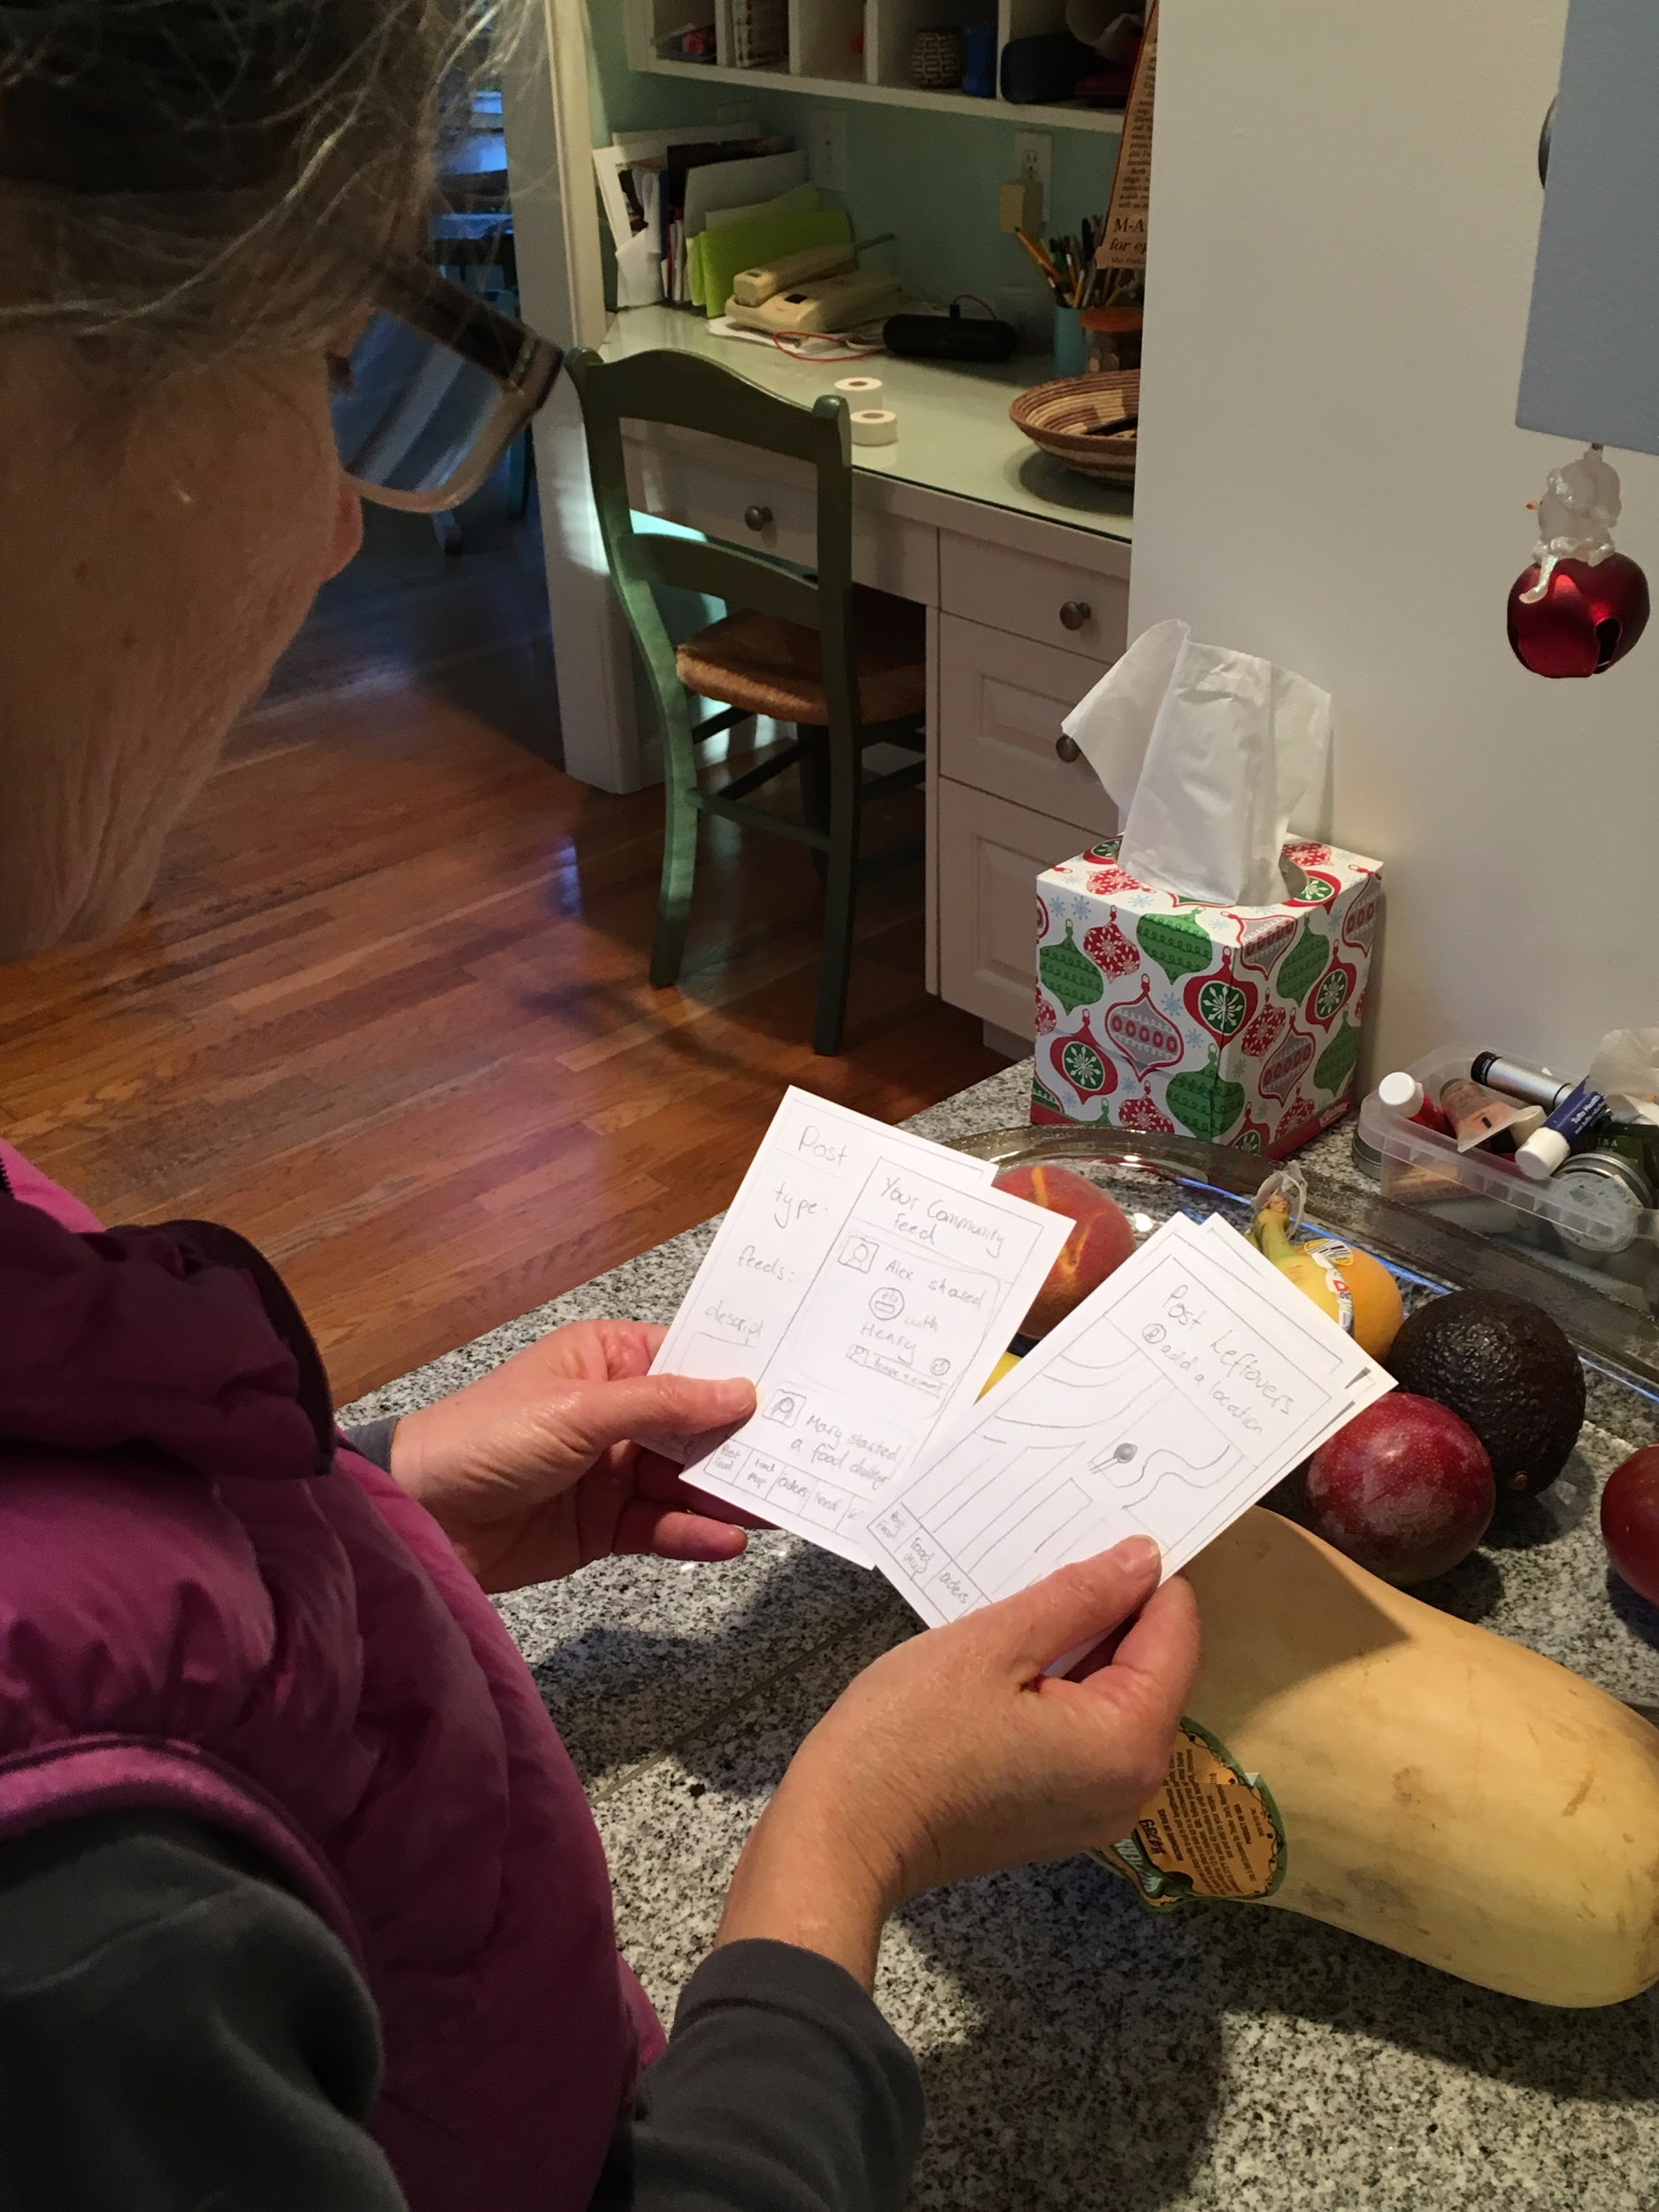
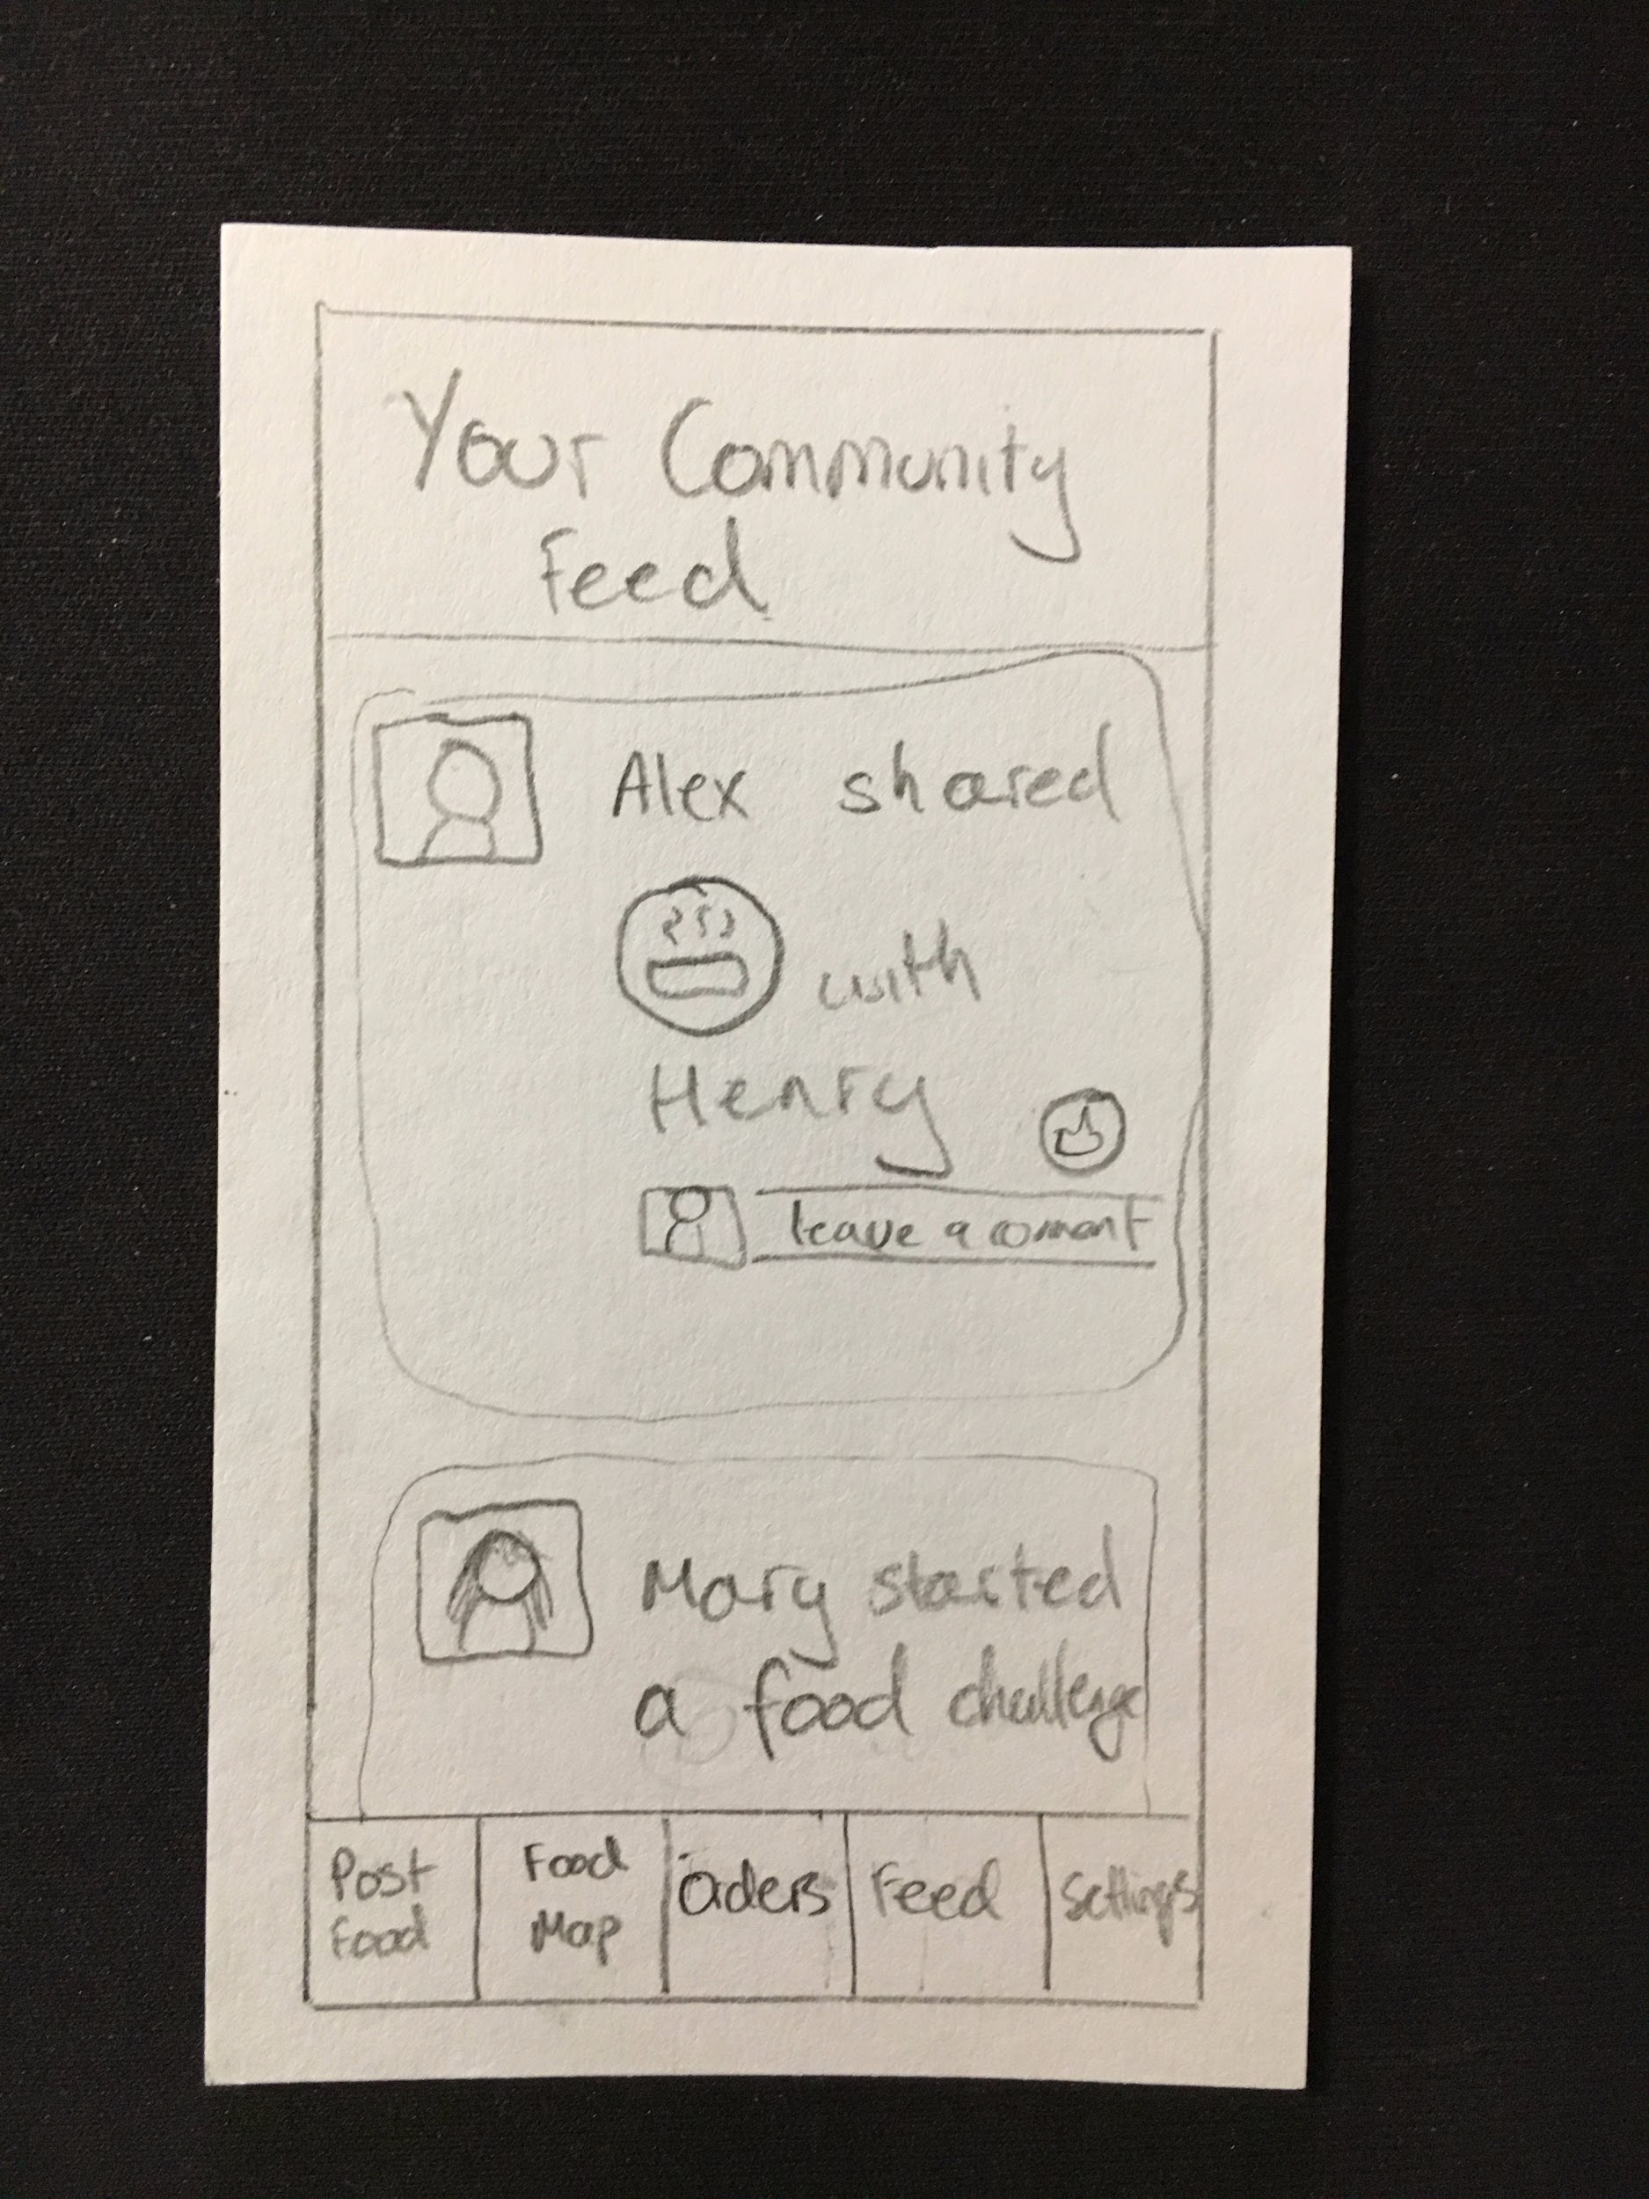
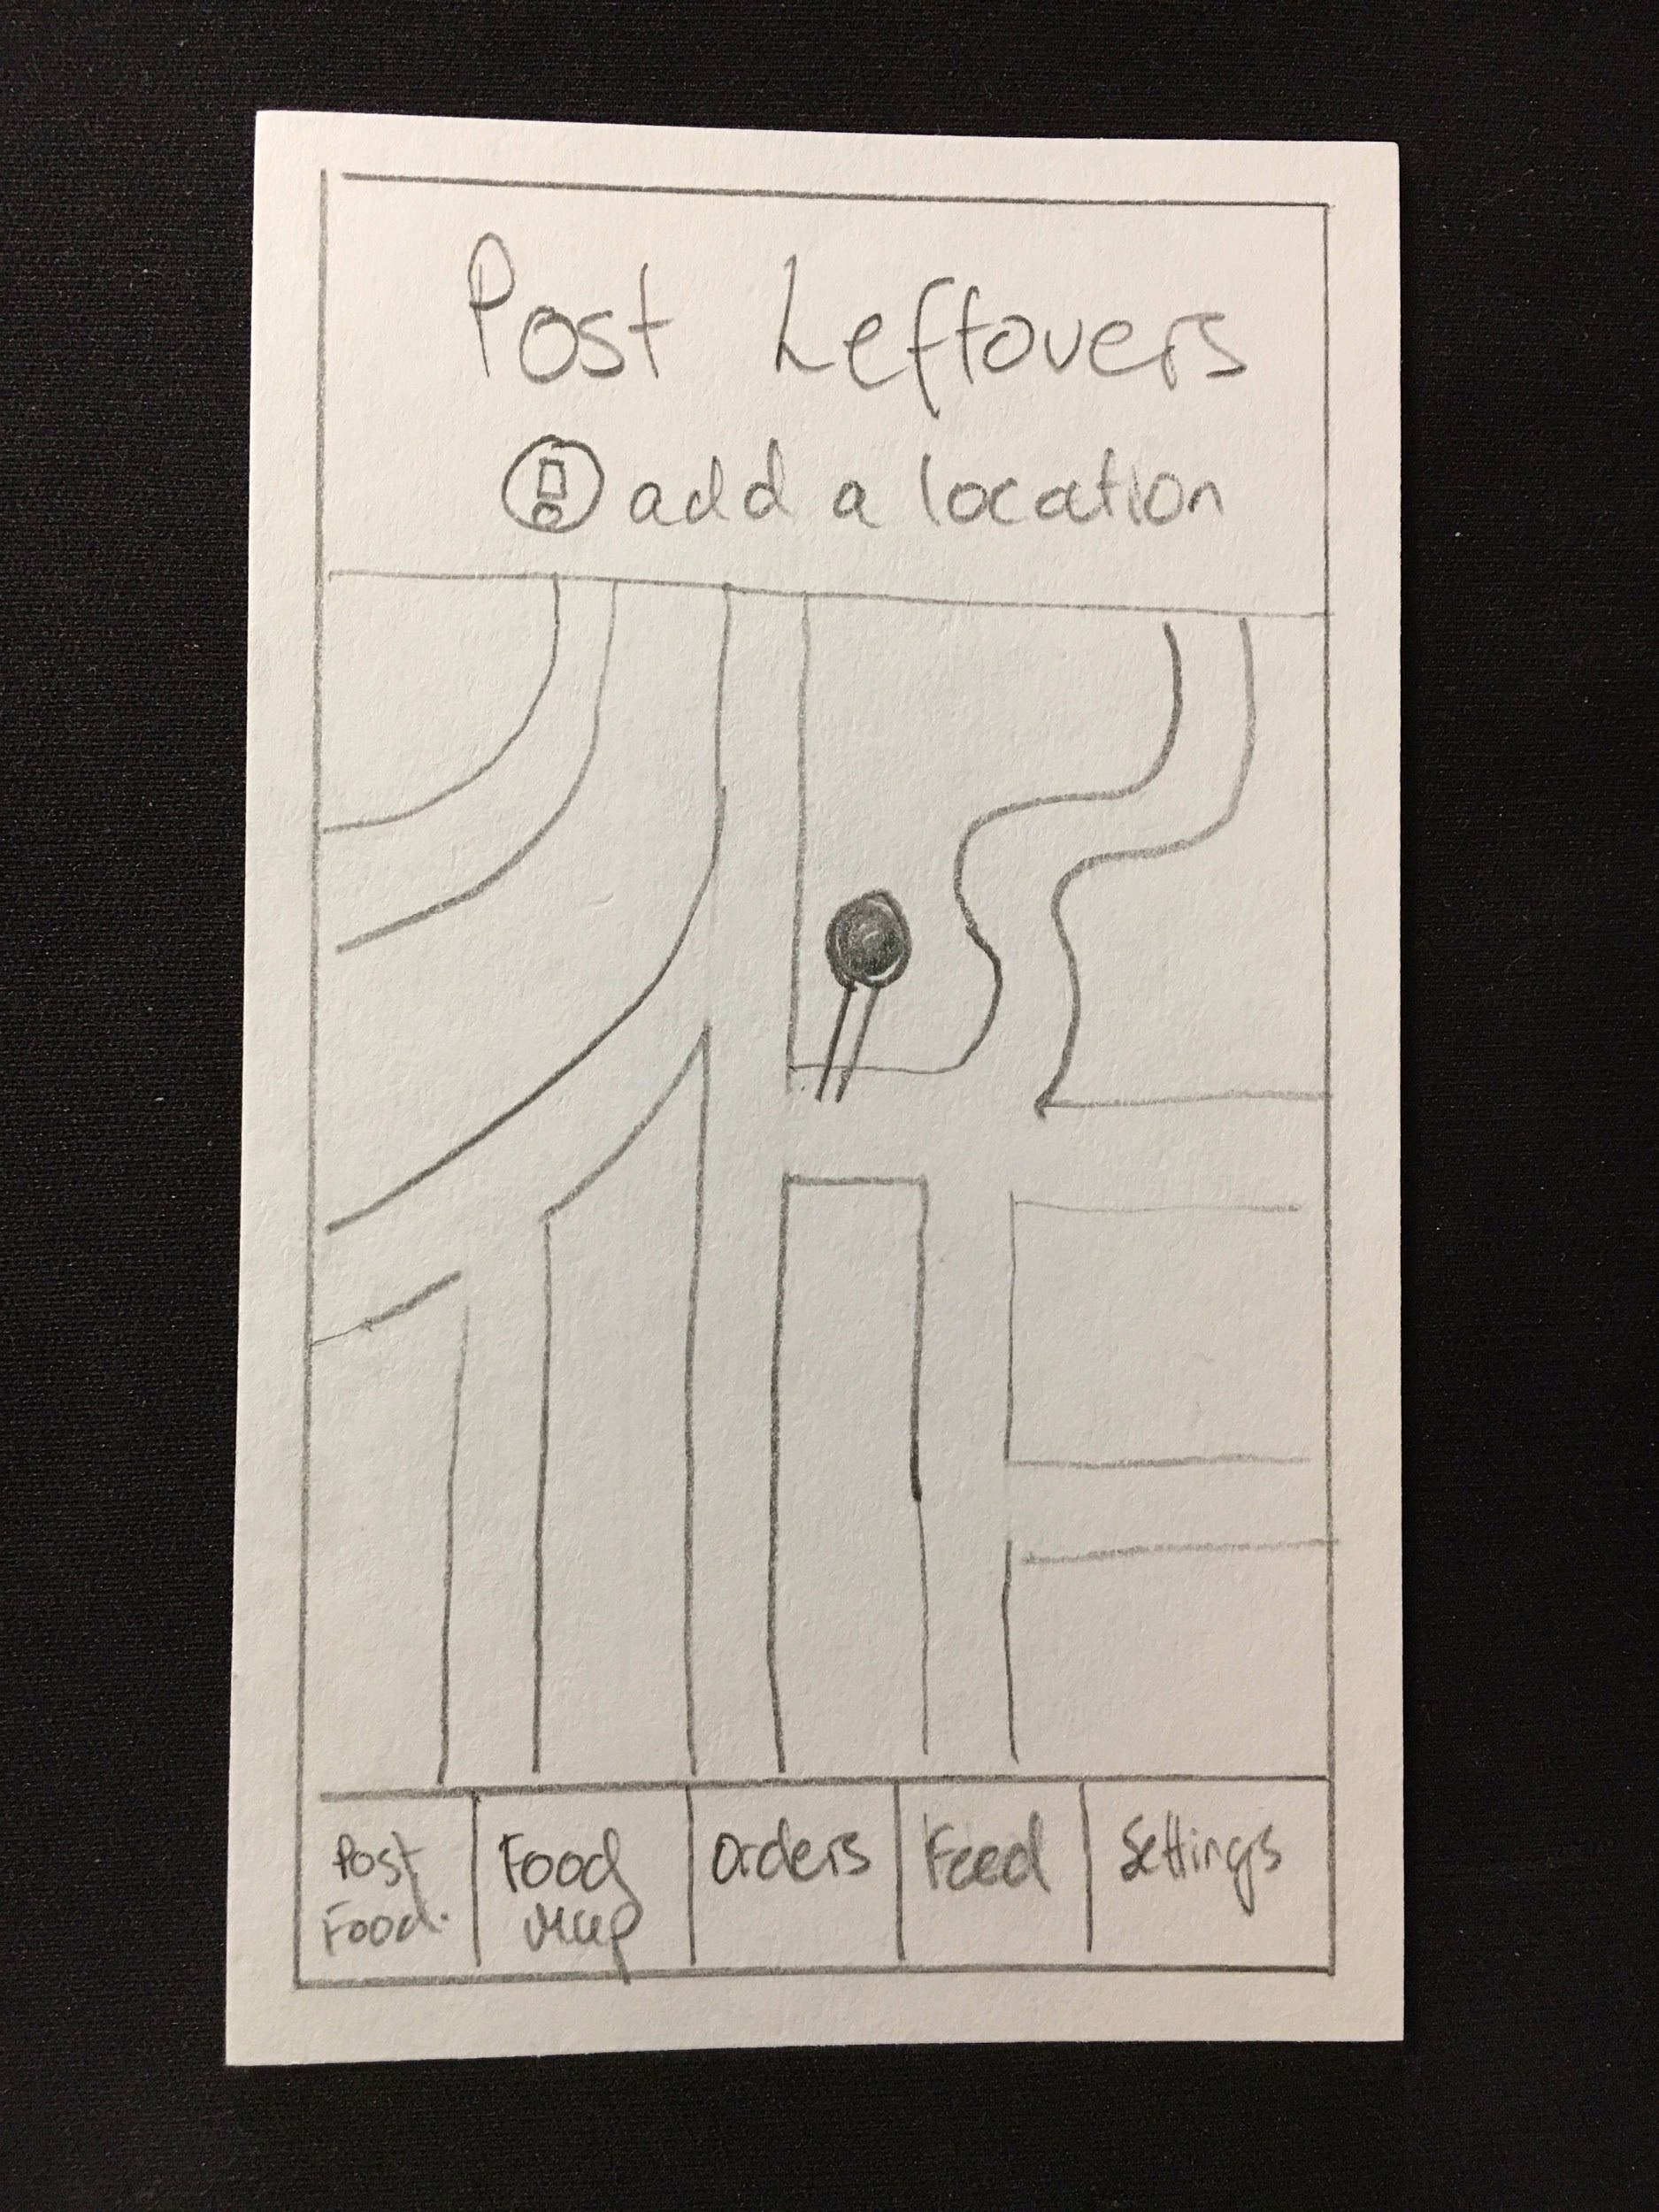
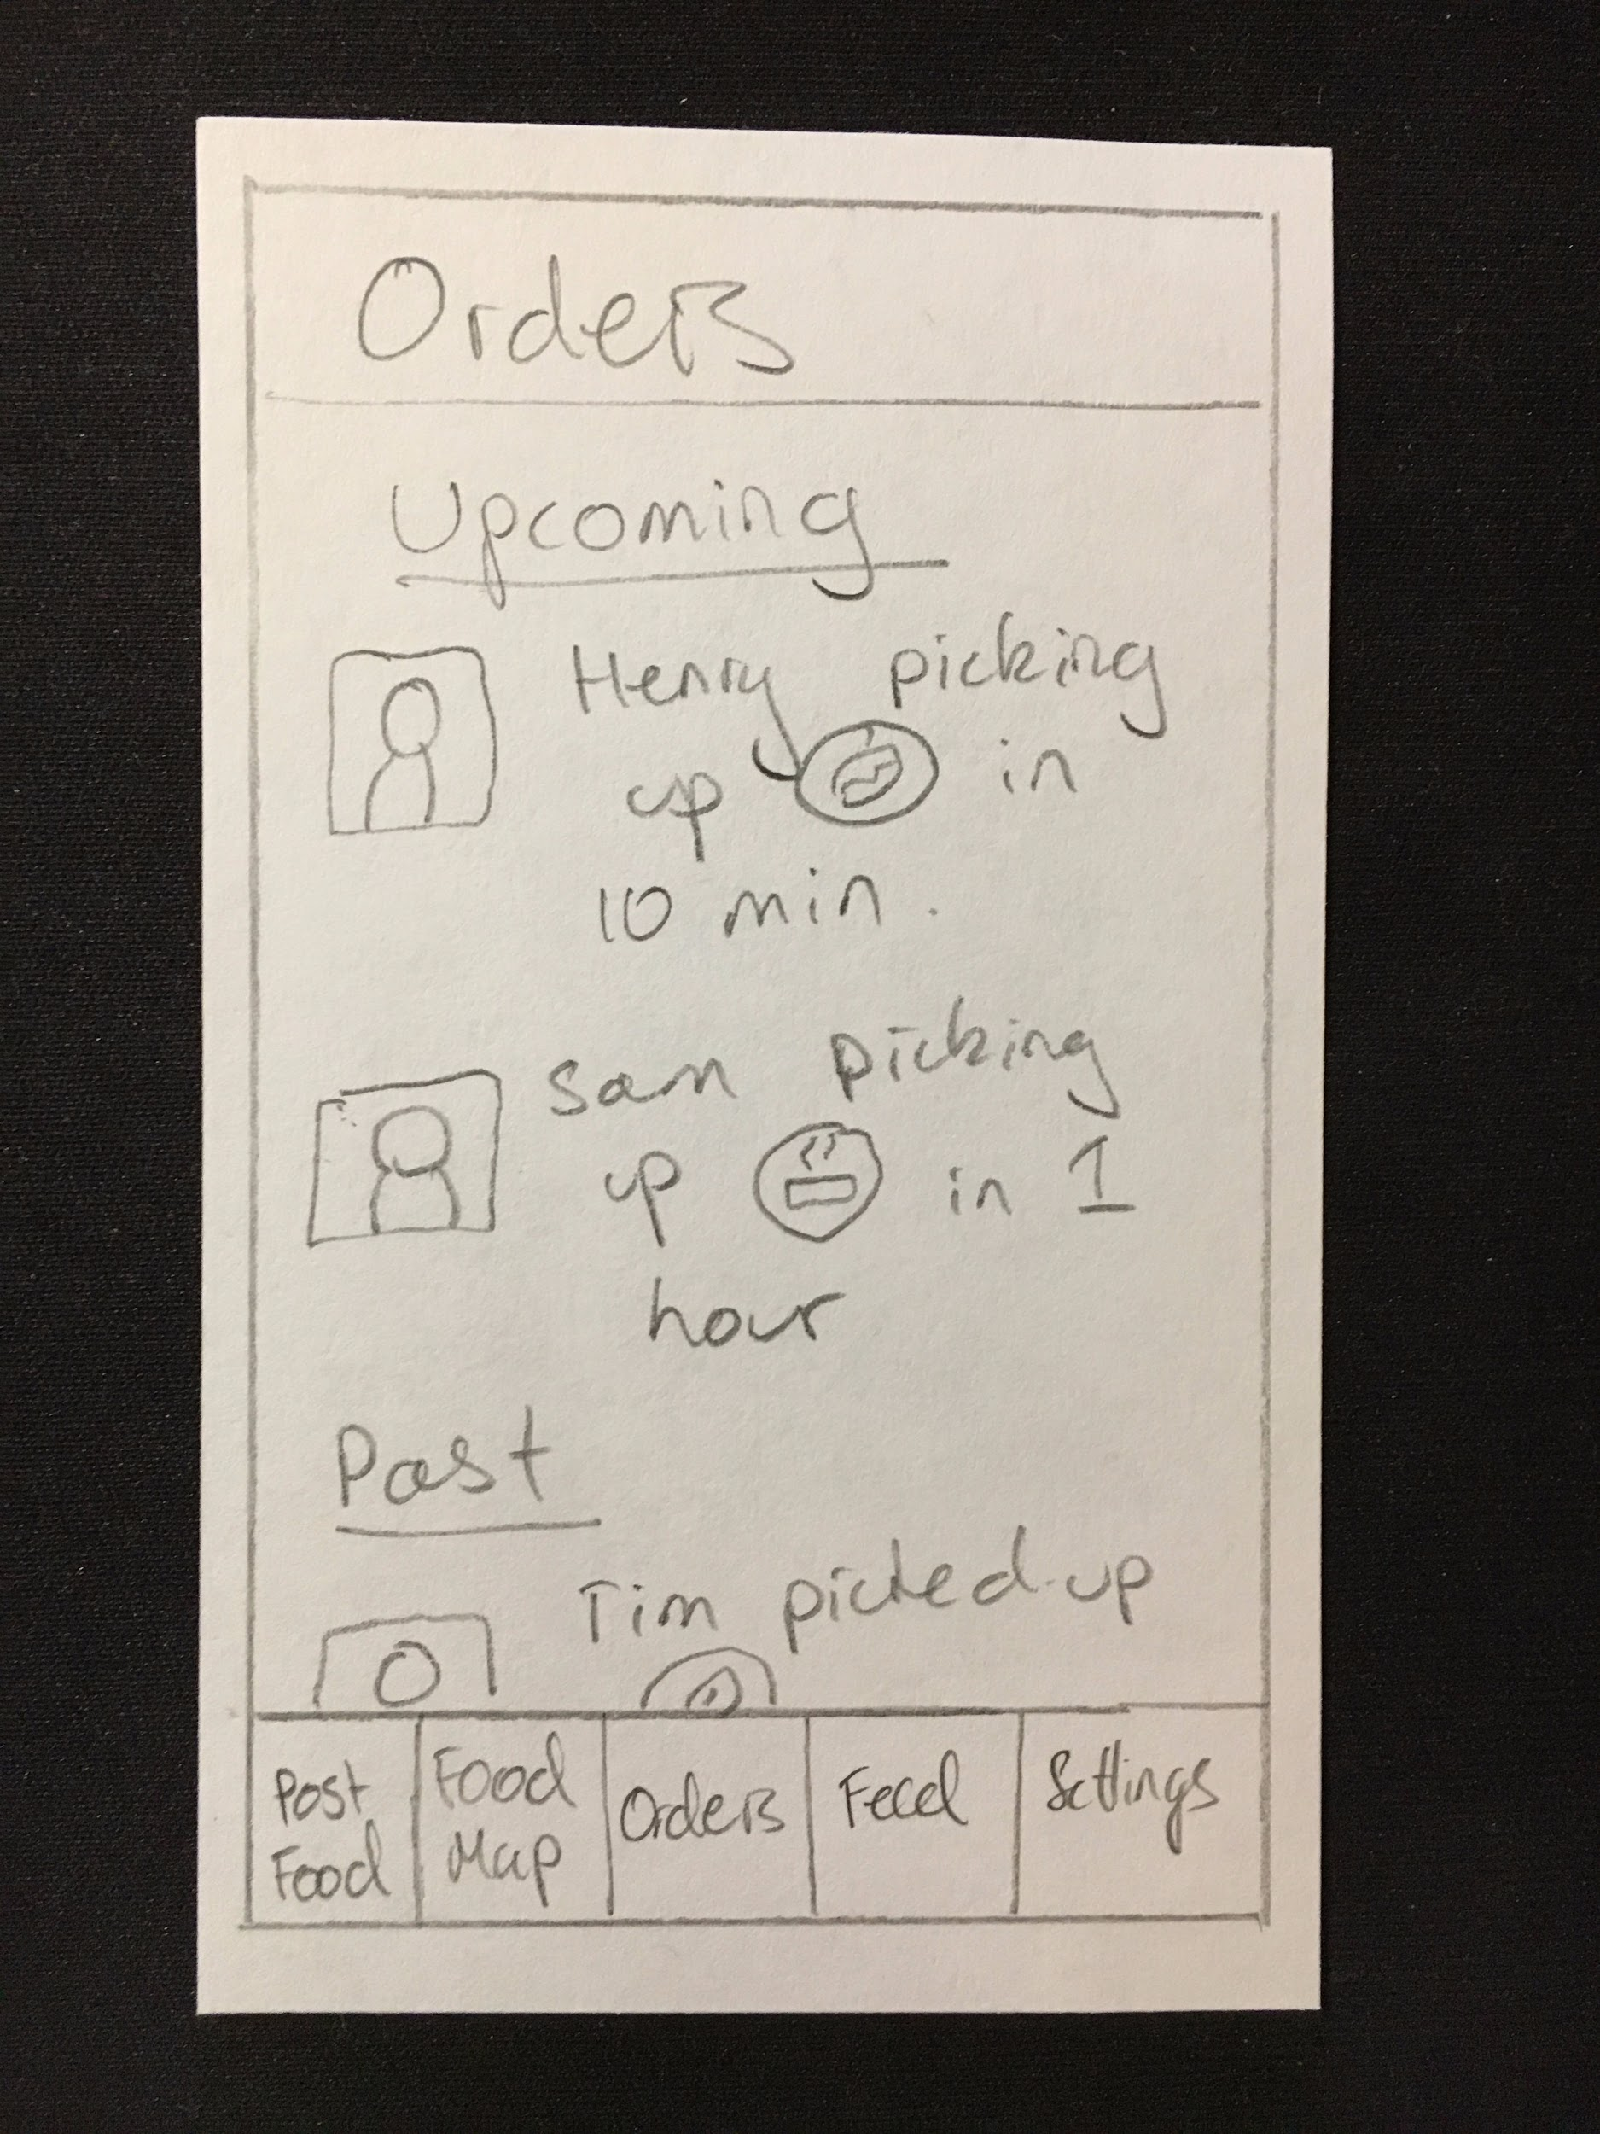
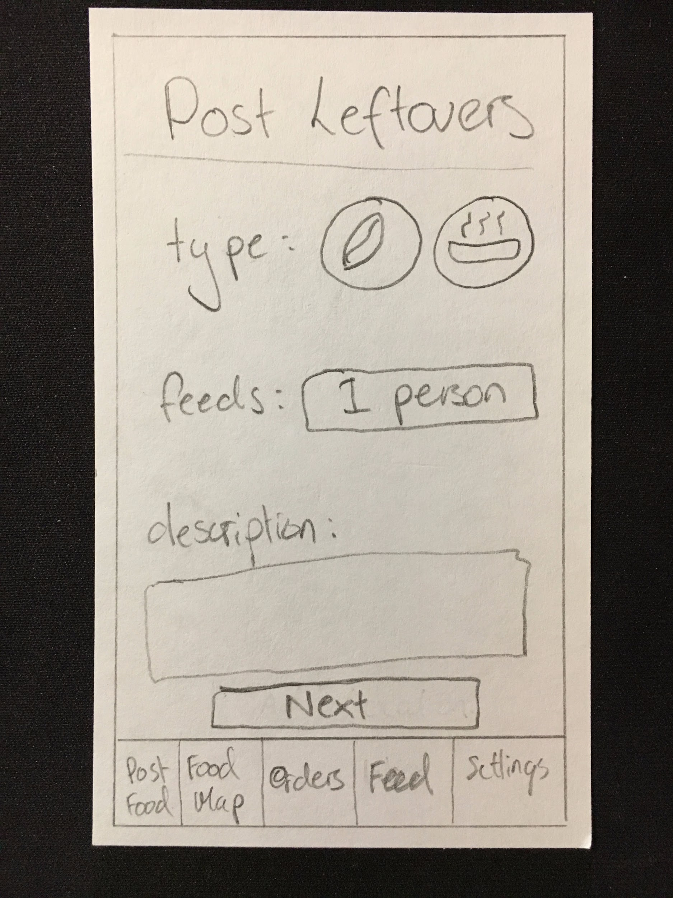
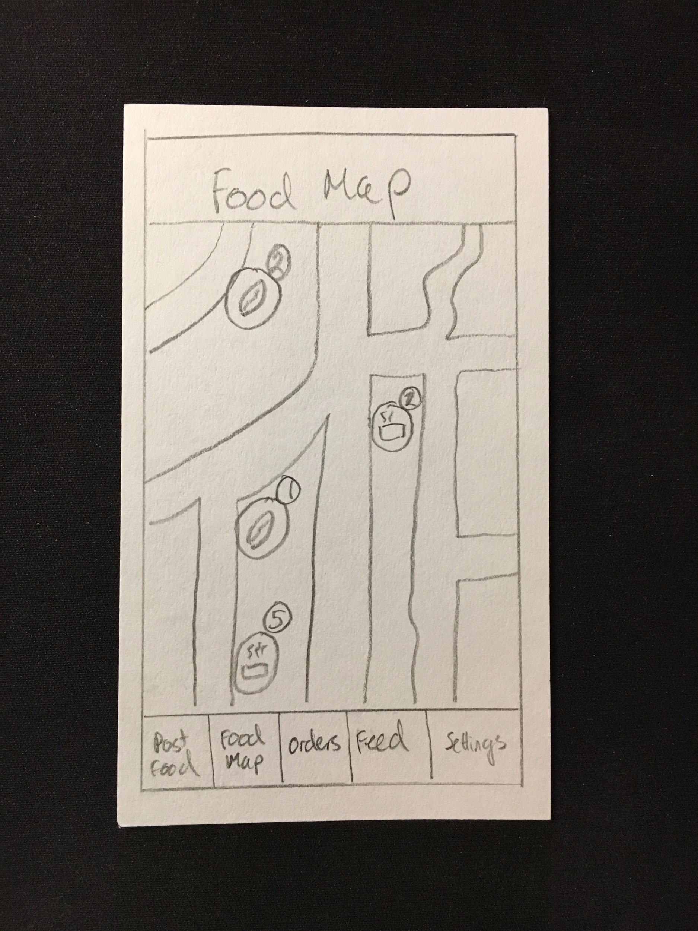
PROTOTYPE: Food Community
Idea: Make sharing and reusing leftover food normal practice within communities
Participant: Gail Blumberg, Menlo Park domestic household

Slide 24
What Worked | Didn’t Work | Surprises and New Learnings
Quick and easy to post available food Amounts of wasted food from households sufficient to fuel idea Easy to browse food close to you Competitions inspired higher likelihood of continued use | Food can’t be left outside indefinitely, unclear how long it takes to pick up Browsing food by location not useful for making require certain ingredients Making donors think about perishable goods ahead of time | People who share food within their community might not want to have a face-to-face interaction (social opt-out) Security a big issue (potentially overcome with mutual friends)

Slide 25
Assumption | Validity
Households would offer up leftovers instead of throwing them away if it were easy to do so. | Valid: “being able to donate food with 3 button pushes is very quick”
Households generate enough waste to make this worthwhile. | Valid: “I cook for myself and still generate a lot of waste, especially when traveling”
People are willing to share food with strangers that come to their door. | Invalid: “I would only open my door to people I know, or people I have mutual friends with”
Food is a strong enough concept to build a community around. | Valid: “I’m always talking with friends about sharing food”
Competition within groups is an effective motivator. | Valid: “Families always go crazy over that sort of stuff”

Slide 27

PROTOTYPE: Food Community
What We Learned: User’s Needs
Security of donors
Donate without being forced to be social
What We Learned: Our Solution
Fast pickup so that food doesn’t go bad
Browsing food by location not always optimal
Donors will not think about donating perishable goods ahead of time

Slide 28
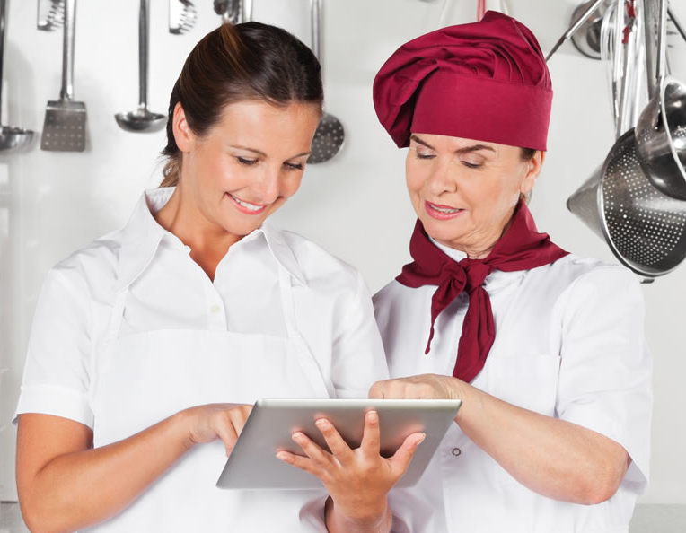
PROTOTYPE: Food Preparation Prediction Tools
What We Learned: User’s Needs
Bridging the communication gap between front house (management) and back house (chefs)
Raw data on food trends ahead of time
What We Learned: Our Solution
Creates a mobile interface with a user-friendly UI that replicates current desktop tools
Managers are happy with raw data in a spreadsheet
Equipping chefs with the mobile app in a time-pressed environment might not solve the problem

